Slide 1



DETECTION OF PNEUMONIA FROM CHEST X-RAY IMAGES USING CONVOLUTIONAL NEURAL NETWORK AND TRANSFER LEARNING
PRESENTED BY – Lakshmi Soundarya Chakka

Slide 2
ABSTRACT
The diagnosis of the disease need lot of analysis and the doctor has to check all the insights of the x-ray image. The x-ray image will be taken by the scanner with ultra sound. The generated x-ray images are different that are compared with the normal images. In order to obtain the insights in a more accurate in less time lot of research is going on medical records. An in-depth exploration of the 'Chest X-Ray Images (Pneumonia)' dataset, an adapted version from Paul Mooney's collection. The dataset comprises radiological images with distinct categorizations into 'normal' and 'lung opacity' cases, indicative of the presence or absence of pneumonia. The dataset distribution reveals a total of 5,856 observations, split into training, validation, and testing subsets. The deep learning methods are easily used so that the patterns from the x-rays will be easily scanned by the neural network algorithm then only the doctor will survive the patient from the disease. We proposed classification between the normal cases and the lung opacity cases. VGG16 and DenseNet 169 CNN architectures were leveraged for feature extraction given their state-of-the-art performance on medical imaging tasks. The models were trained end-to-end with no non-trainable parameters. The hyper parameter tuning will increase the results to more than 95%. To classify the diseases we have taken the machine learning library keras. The base model will be developed using the transfer learning and the custom deep convolution neural networks. The Adam Optimizer is to reduce the connections between the layers to improve the accuracy in order to produce the best results. The categorical cross entropy is the loss function is used to test the trained model with the different set of images whether it is classify the disease correctly or not. So our model provides the accuracy to classify the x-ray images as normal or the lung opacity disease. The automatic classification of the medical x-rays will be done effectively then there is a chance of the low death rates because the patients will get the treatment in time.

Slide 3


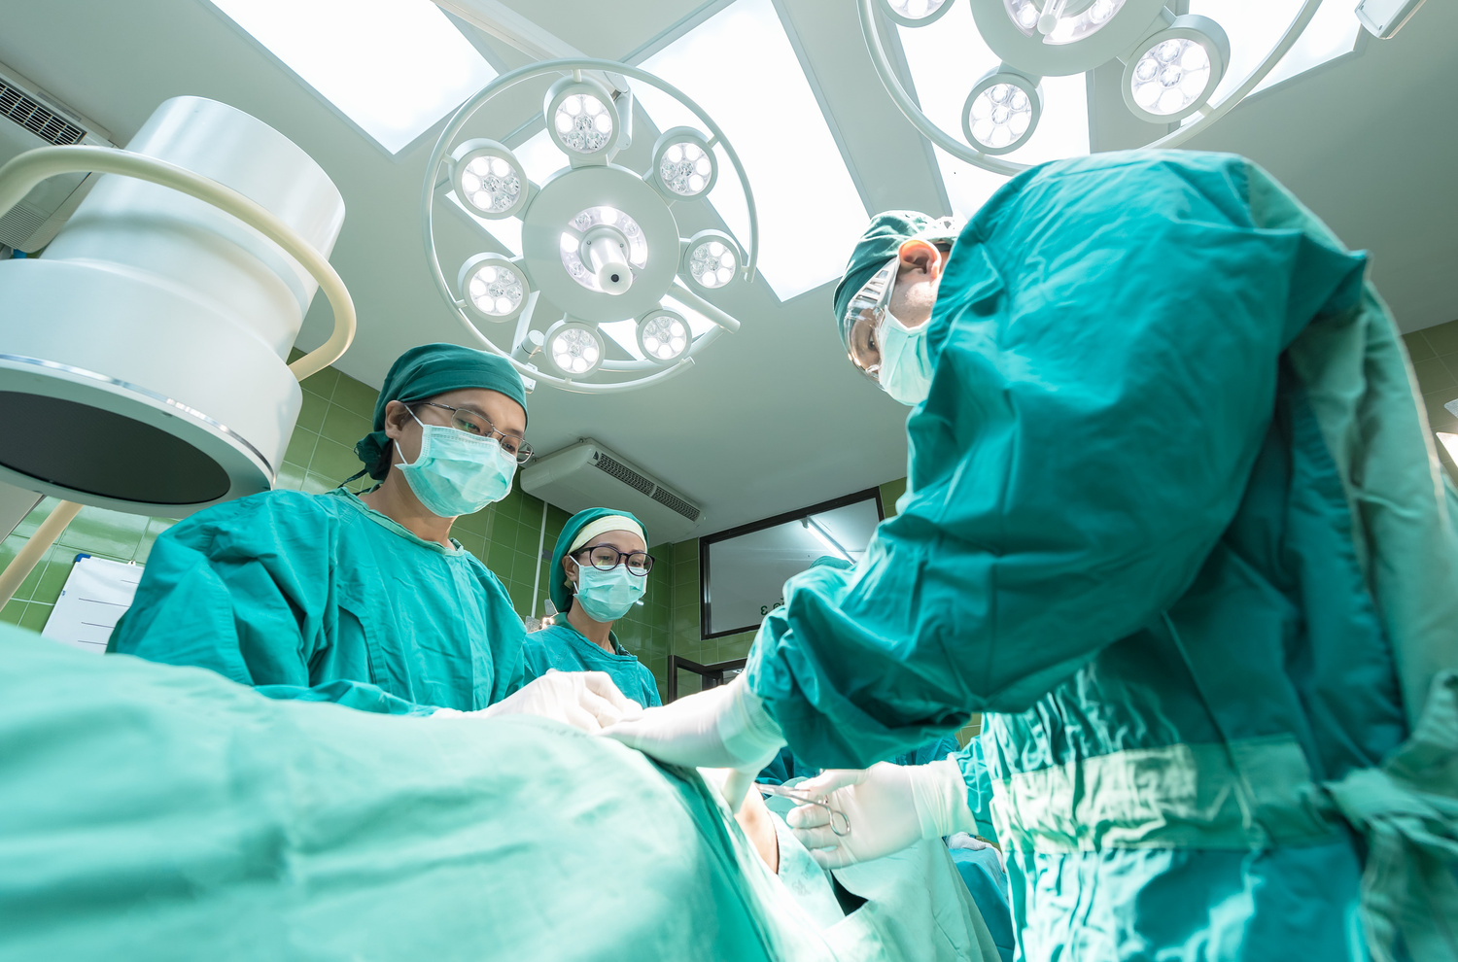

INTRODUCTION
The pneumonia is a disease which is caused due to the inflammation of the both the lungs caused by the bacteria. This is acquired when a person inhales air carrying germs. The following are the symptoms where the user is facing
HIGH FEVER
HIGH CHILLS AND SHIVERING
MUSCLE AND CHEST PAIN
DIFFICULTY INBREATHING
The age of young children and between the ages of 65 are in the risk where pneumonia can be attacked and it leads to failure of the respiratory system which leads to fatal death of the person.

Slide 4
PROBLEM STATEMENT
The lung functionality is inhale and exhale of breathing can be taken. The total lung capacity is 6000ml of oxygen for humans. The swelling or inflammation of the bronchial tubes and irritation of the bronchial tubes causes diseases. The lung diseases are categorized into emphysema, cystic fibrosis/ bronchiectasis, asthma, lung cancer pneumonia and plural effusion etc. Among all the diseases the 27% of the effected people (young or old) with the disease of pneumonia. The pneumonia is nothing but accumulation of water or fluid in the lungs and it is caused by the bacteria named streptococcus pneumonia. The diagnosis of the disease can be done through the chest X-ray and blood tests like CBC (Complete Blood Count).The physiological parameters like pulse Oxymeter readings are also used to diagnose the disease. The pneumonia Chest X-ray gives the information of white spots in the lungs which infiltrates to identify the lung infection. The infected area depicts like the white spots in the black background of the chest X-ray.

Slide 5
OBJECTIVES
Classifying radiological patterns in X-ray images, specifically targeting the detection of pneumonia manifestations. The dataset's bifurcation into normal and lung opacity cases serves as labeled data for supervised learning. The low biased dataset is used to classify the Pneumonia from Chest X-Ray images using Custom Deep Convolutional Neural Network.
Fine Tune the already trained model on the dataset of pneumonia pre-trained model with VGG 16 with Dense Net (Transfer Learning) with 5856 images of X-ray (1.15GB). For tuning we are removing the output layers and store the first few layers to fine-tuned model for two new label classes (Pneumonia and Normal).
01
02
03
The Customization of Convolutional Neural Network by adding fusion layers to attained with the testing accuracy 90%.

Slide 6

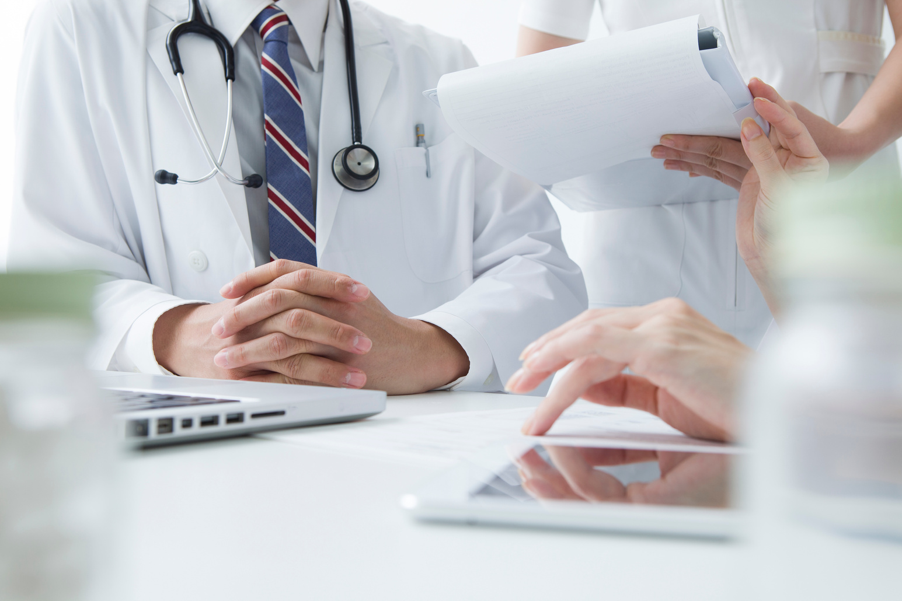
Literature Review
The Literature review discuss about the various aspects that are being used to fulfill the objectives specified in the research objectives. The following are the topics that are used to develop the model that performs well.
Classification with posterior and anterior graph
Spatial Sparseness and overfitting of data Transfer learning with custom Classifiers
Transfer learning with custom Classifiers
Enhanced Deep Learning for Feature Extraction
Importance of Model & Classifier in identifying the patterns

Slide 7




The flow of proposed system contains the data collection and eliminates the preprocessing, extraction and selection of the features, creating a model, calculating the model performing using the metrics.
Data Ingestion: Relevant Python libraries and dependencies are imported to facilitate data handling, analysis, and model building.
Data Structuring: A data frame, a two-dimensional labeled data structure, is instantiated to streamline the dataset's organization, enabling efficient manipulations and operations.
Exploratory Data Analysis (EDA): Preliminary investigations are conducted on the dataset to uncover underlying patterns, anomalies, or relationships without resorting to formal modeling. This typically involves visualizations, statistical tests, and data summaries.
Data Preprocessing: Prior to modeling, the X-ray images undergo a series of transformations to enhance their quality, normalize their sizes, and ensure their compatibility with machine learning algorithms.
The Testing and the Validation of data contains the images that are being tested with the model to know the accuracy. The Model Parameters that are used in epoch, step size, optimizer, and loss function, learning rate and the path of the both training and testing data. The machine learning library that are using is the keras. The Base model that is used is Vector Graphic Geometry-16 and Densenet169
METHODOLOGY

Slide 8
THE DATA LOADING
The data is collected from the kaggle (Chest X-Ray Images (Pneumonia)|Kaggle) and the number of classes are 2 (Normal and Pneumonia Images).The Training data contains the 1400 Images and each image of size 224x224.The Validation data contains the 320 images and the Testing data contains the 320 images. The training data is used to train the model (store all the recognize patterns into the single file and make it available when the image comparison is done).
The loading of the image can be provided by path and the size of the image is 224x224. The image is converted into an array so that the model can compare all the arrays with less time. The preprocess can be done on the image by avoiding the unnecessary data or the features that are not needed to detect the person is suffering with pneumonia. The model will predict the input image data with the model trained data.
DATA COLLECTION

Slide 9
DATA AUGMENTATION
The data augmentation can be done by using the Image Data Generator is used to normalize the data. The rescale is the option used to convert the 0-255 values to 0-1 it means the normalization of data can be done. The shear range is the rotation of the image leads to clockwise and the anti-clock wise direction. The clock wise deals about the image was turn towards the left side and the anti-clock wise is the image rotates towards to the right side. The flip option is used to turn the image top - bottom and bottom - top. The vertical flip is nothing but flipping the image from top to bottom and the horizontal flip is turns the image left to right and right to left.
The data collection is used to download from the kaggle and the data dependencies are the token API that is needed to download the data. Once the data is downloaded to check if the classes are balanced. As the dataset is not balanced, class weights are calculated and applied during model training.
DATA COLLECTION

Slide 10
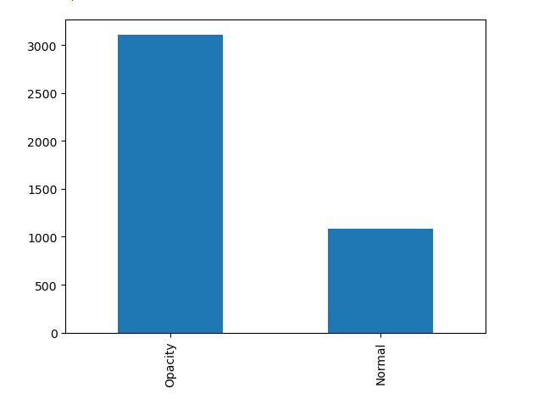
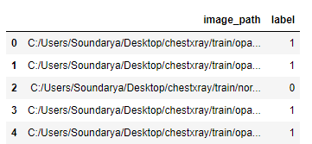
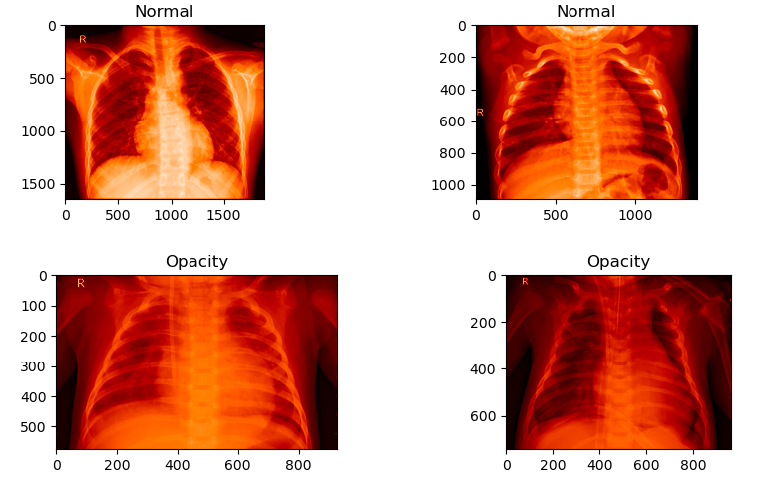
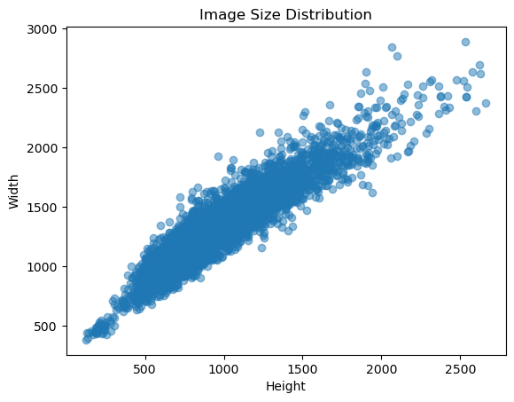

Slide 11
TRAINING AND VALIDATION OF ACCURACY & LOSS
DATASET DISTRIBUTION
• TOTAL OBSERVATIONS (IMAGES): 5,856
• TRAINING OBSERVATIONS: 4,192 (1,082 NORMAL CASES, 3,110 LUNG OPACITY CASES)
• TESTING OBSERVATIONS: 1,040 (267 NORMAL CASES, 773 LUNG OPACITY CASES)
• VALIDATION OBSERVATIONS: 624 (234 NORMAL CASES, 390 LUNG OPACITY CASES)
DATA PREPARATION AND ANALYSIS
THE DATASET IS INITIALLY ORGANIZED INTO DATA FRAMES TO FACILITATE DATA HANDLING. A CURSORY ANALYSIS PROVIDED INSIGHT INTO THE DATASET'S STRUCTURE AND DISTRIBUTION. VISUALIZATIONS, INCLUDING BAR PLOTS, SHOWCASED THE BALANCE BETWEEN NORMAL AND OPACITY CASES IN THE TRAINING DATA.

Slide 12
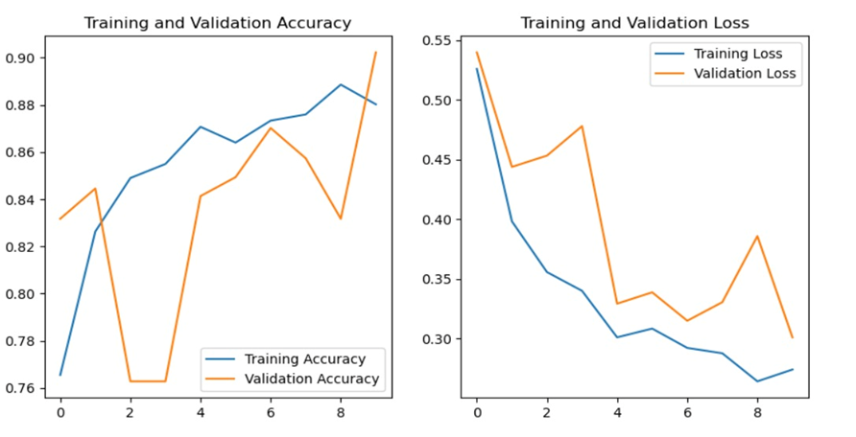
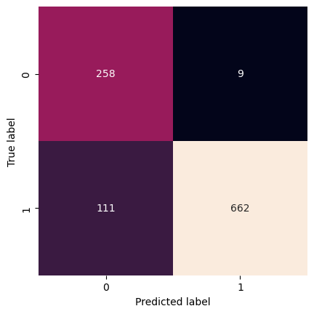
VGG16
TRAINING AND VALIDATION OF ACCURACY & LOSS
CONFUSION MATRIX

Slide 13
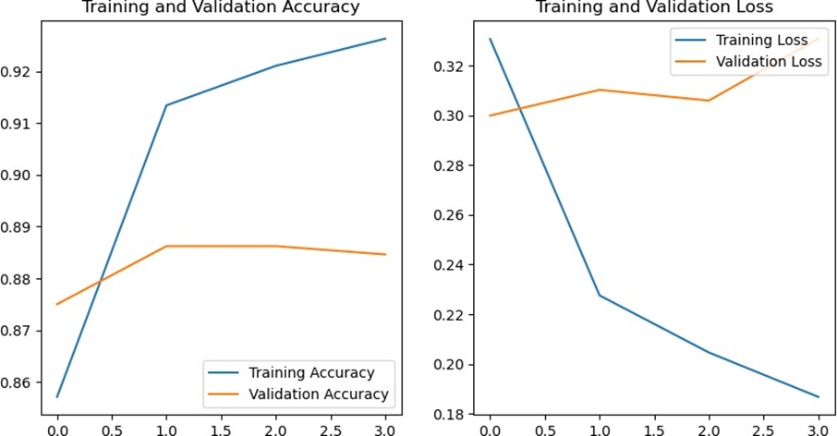
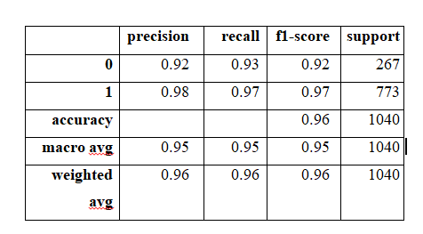
TRAINING AND VALIDATION OF ACCURACY & LOSS
PERFORMANCE METRICS OF THE MODEL

Slide 14
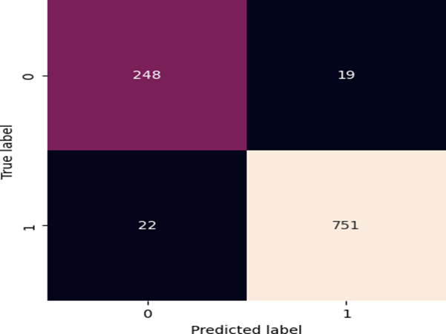
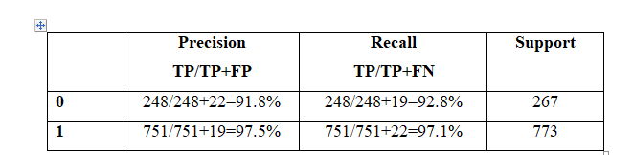
The confusion matrix is one of the matrix which is used to identify the differences between actual and the predicted so there are two classes in actual it is positive and negative and in predicted also it has positive predicted and negative predicted so the four parameters that are relates in between actual was a predicted are true positive, false negative, false positive and true negative or the values that are going to identify the pneumonia or normal disease images.
CONFUSION MATRIX
METRICS CALCULATION

Slide 15
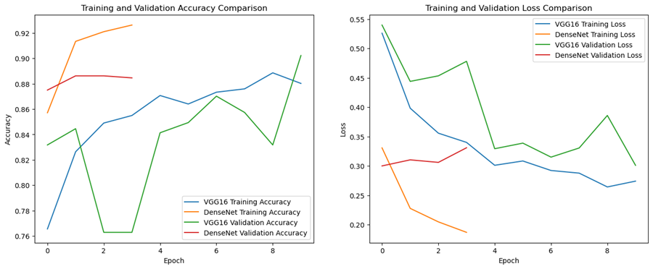
Training Accuracy: Both models show a similar trend in training accuracy, with DenseNet having a slightly higher accuracy than VGG16. The training accuracy is increasing for both models, which is a positive sign.
Validation Accuracy: Again, DenseNet shows a slightly higher validation accuracy thanVGG16. The validation accuracy is also increasing, though it is less smooth compared to the training accuracy.
Training Loss: Both models show a decreasing trend in training loss, with DenseNet having a slightly lower loss compared to VGG16. This is consistent with the increase in training accuracy.
Validation Loss: The validation loss is decreasing for both models but seems to have more fluctuations. DenseNet shows a lower validation loss compared to VGG16.
Overfitting: In this case, both training and validation losses are decreasing, so there's no clear evidence of overfitting at this stage.
Model Performance: From this plot, DenseNet seems to be performing slightly better than VGG16 in terms of both accuracy and loss on the given dataset.
Model Comparison

Slide 16
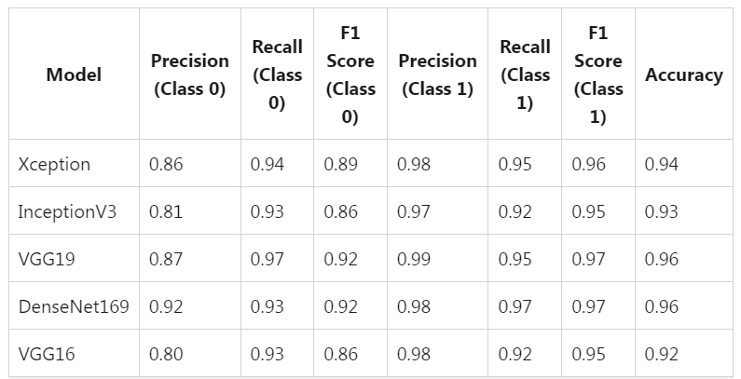
Performance Metrics of the Models

Slide 17
CONCLUSION
Both VGG16 and DenseNet169 have been used extensively in various computer vision tasks, such as object detection, image segmentation, and classification. While VGG16 is simpler and more straightforward, Dense Net's dense connections make it more parameter-efficient and enable it to capture more complex patterns. Both VGG16 and DenseNet169 displayed commendable capabilities in detecting pneumonia from X-Ray images. While both models were adept at the task, DenseNet169 had a marginally superior performance on this specific dataset. This analysis underscores the potential of deep learning in medical image analysis and its significance in real-world healthcare applications.

Slide 18
FUTURE WORK
The major limitation of these algorithms needs lot of data in order to improve the accuracy and it needs more computing power to implement the more trainable parameters. The deep learning mechanisms itself is having complex neural network architectures for training the model and to upgrade the model with the hybrid network algorithms. The recommendation systems will be more beneficial as sometimes it may be the virus. The influential parameters will be tested by taking the symptom from the Large Language Model. The Model itself is identifying and analyzing the disease using the historical data of the patient and the model will easily predict the disease in advance to rescue the person from severe disease.

Slide 19
THANK YOU

